Slide 1

AN OVERVIEW OF ICT TECHNOLOGY ADVANCEMENT

Slide 2

Information and Communication Technology (ICT)
is a wider umbrella term that covers different types of technologies —both hardware and software technologies—associated with the communication systems, techniques, transmission media, software programs, protocols, sensors, and standards.

Slide 3
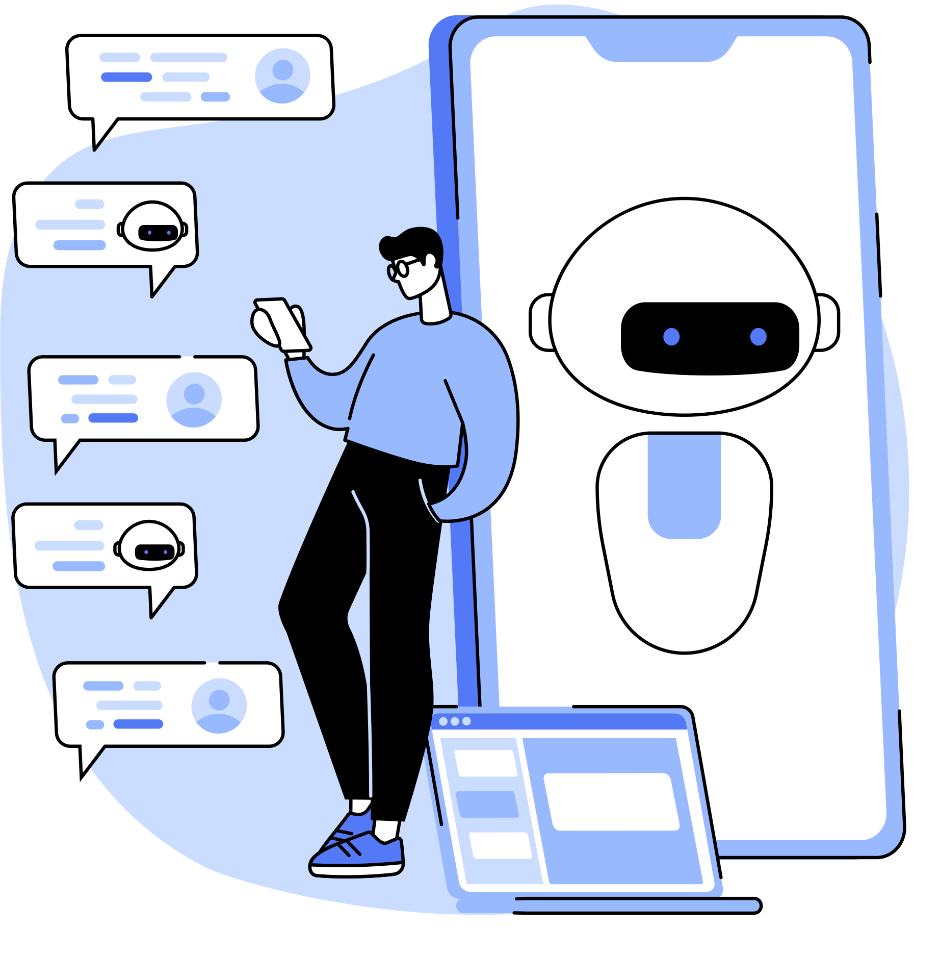
Cyber-Physical Systems (CPS)
A CPS system is a computer-based system whose core mechanism of operation and function is monitored and controlled by computer programs, commonly referred to as software algorithms or applications and integrated through communication networks for effective coordination and communication among the ICT elements

Slide 4
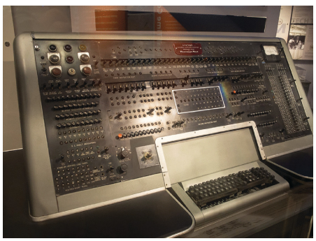
An Overview of ICT Advanced Technologies
The emergence of modern ICT technology can be traced back in early 40s when the Word War II (WWII) was going on. The first commercial computer developed in 1951 was named as UNIVAC I

Slide 5

Main Areas of ICT Technologies
Hardware Technologies
Software Technologies

Slide 6
hardware technologies
Hardware technologies used in ICT field include the capabilities of different electronic devices or materials for processing, storing, transporting, inputting, and outputting data or information in the form of signals.
Data processing hardware
Data input hardware
Data output hardware
Data transmission hardware
Data storage hardware.

Slide 7

data processing hardware
Data processing is an electronic technology powered by the associated software program to run different types of operational processes on the electronic signals to generate different results based on those operations such as NOR, NAND, OR, addition, multiplication, and others.

Slide 8

data input hardware
The data input hardware can be either simple data input devices that feed data manually to the computer processing units or automated signals through range of sensors in the modern IT processing applications.

Slide 9
data output hardware
The output hardware is a type of ICT hardware that is used to display, present, or express the output data or information, which is processed by the processing hardware.

Slide 10
data transmission hardware
Data transmission hardware is a range of equipment that consists of transmission media, connectors, and physical interfaces that connect data sender and data receiver devices.

Slide 11
data storage hardware
Information Technology hardware used for storing the data in different forms and formats for the future use is known as the storage hardware.

Slide 12
Software Technologies
The impact of the software technologies on the overall domain of ICT is huge because they play very vital role in the materialization of the modern IT ideas, applications, devices, equipment, and industries.

Slide 13
firmware
A firmware is a kind of software code that is developed for a small device-specific hardware to provide low-level control over the operations of that particular electronic device.

Slide 14
operating systems
Operating system is a larger software program that is designed to provide high-level control over a complex device to perform a wide range of functions, tasks, and activities under a hardware environment, especially computer-powered devices, equipment, and tools.

Slide 15
it protocols
IT protocol is a set of rules, syntax, communication synchronization, semantics, and communication error recoveries for establishing a smooth and predictable communication between two or more than two network elements.

Slide 16
programming languages
The main purpose of computer programming language is to build a software program that can implement, manage, initiate, and terminate the algorithm for performing an automated task through computation by exchanging the data among the concerned entities

Slide 17
software development methodologies
A proper software development methodology can help developers, engineers, consultants, and IT pioneers to foresee the right need of idealistic demand of the technology market and plan the development in such a way that it achieves the desired targets in a very short span of time as well as under the competitive budgets.

Slide 18
Evolution of it
The evolution of information technology encompasses a wide range of technologies in different domains such as engineering hardware, software, data storage, transmission media, internetworking methodologies, data security, and many others

Slide 19
Computer generations
Zero Generation (1642–1945)
First Generation (1945–1954)
Second Generation (1954–1963)
Third Generation (1963–1973)
Fourth Generation (1973–1985)
Fifth Generation (1985–Present)

Slide 20
Zero Generation (1642–1945)
This generation of computers is also known as the mechanical computer era. The most common examples of the computer machine development in this tenure are (see the above list) like the Pascal calculator, Leibniz calculator, Babbage’s Difference Engine, and so on.

Slide 21
First Generation (1945–1954)
The first generation of the modern computers is also referred to as the “Vacuum Tube Computer Era”. In this generation, the core technology used for processing, transmitting, and storing the data was vacuum tubes. The examples of first-generation computers include Colossus made by British Government, ENIAC project, and UNIVAC I computers

Slide 22
Second Generation (1954–1963)
The second-generation computers are based on an advanced technology known as electronic transistor for switching, processing, and storing the electronic signals in this generation of computers. The main examples of 2nd generation computers include IBM 1400 Series and DEC PDP-I Series computers.

Slide 23
Third Generation (1963–1973)
The third-generation computers are classified based on the integrated circuit (IC) technology, which is much faster than individual transistor. The example of the computers pertaining to the 3rd generation include IBM PC, Intel 4004 chip, and others.

Slide 24
Fourth Generation (1973–1985)
The fourth-generation computers are characterized by the scale of integration of transistors. This generation of computers used the integration technology known as “Very Large-Scale Integration”, precisely referred to as VLSI technology. The examples of computers of the 4th generation include MITS Altair 8800, IBM PC, and Apple computers.

Slide 25
Fifth Generation (1985–Present)
The 5th generation computers are characterized by the advanced technologies supporting parallel processing, networking of the computers, and other capabilities. The integration of transistors in this generation of computers is referred to as “Ultra Large-Scale Integration”, or, more precisely referred to as ULSI technology

Slide 26
Operating System Generations
First Generation (1940–1950)
Second Generation (1955–1965)
Third Generation (1965–1980)
Fourth Generation (1980–Present)

Slide 27
First Generation (1940–1950)
The First generation of operating system was the direct operating access on the computer to the programmers to develop a code in machine language and run on the computer

Slide 28
Second Generation (1955–1965)
The second-generation operating system is marked by the first specialized operating system developed by General Motors in early 1950s, General Motors Operating Systems (GMOS) and was developed for the IBM computers. The main characteristics of this operating system included single stream batch processing and the use of punch cards for input jobs.

Slide 29
Third Generation (1965–1980)
This OS generation is characterized by the multiprogramming functionality in which multiple tasks would be performed through operating system.

Slide 30
Fourth Generation (1980–Present)
The start of modern operating systems is referred to as the fourth generation OS era. In this era, a range of modern operating systems were developed.

Slide 31
Application Software Generations
First Generation
Second Generation
Third Generation
Fourth Generation
Fifth Generation

Slide 32
First Generation
The first-generation software programs can be classified as the mechanical and electrical algorithms to instruct the computers/calculators to perform certain computations. This era starts from the creation of the irst algorithm by Ada Lovelace in 1842 for the Analytical Engine.

Slide 33
second generation
The development and deployment of machine-readable code in different forms that require high-level of expertise, skill, and understanding of the codes is considered as the second generation of the computer software applications

Slide 34
third generation
This era includes numerous software programs such as A-0 and related series developed by Grace Murray Hooper [30]. The other major software applications include FORTRAN, COBOL, LIST, and so on.

Slide 35
fourth generation
The materialization of fourth generation software applications was powered by the high-level programming languages such as C, SQL, and others that pave the way for development of domain-speciic applications to automate different processes without any large-scale intervention of human and other resources on computers.

Slide 36
fifth generation
The interactivity, resource-reusability, code-reusability, responsiveness, backend & frontend scripting, real-time response, and many other additional features of modern software applications characterize the fifth-generation

Slide 37
Programming Language Generations
First Generation
Second Generation
Third Generation
Fourth Generation
Fifth Generation

Slide 38
first generation
The first-generation programming language is known for its characteristics of machine-level programming category. This group of programming languages did not use any compilers or assemblers for the code to deploy.

Slide 39
second generation
The languages in the second generation are also known as low-level programming languages. The main examples of the 2nd generation computer languages include RISC (Reduced Instruction Set Computing), CISC (Complex Instruction Set Computing), X86, ARM (Advanced RISC Machine), MIPS (Microprocessor without Interlocked Pipelined Stages), and others

Slide 40
third generation
Third-generation computer programming languages are more sophisticated, capable, feature-rich, and computer-independent or portable. Examples include FORTRAN, COBOL, C, Java, Pascal, Perl, PHP.

Slide 41
fourth generation
The programming languages dealing with different software development domains such as web development, database management, mathematical optimization, report generation, and others are referred to as the 4th generation programming languages. The examples of the fourth-generation languages include R, Oracle Report, PL/SQL, SQL, ABAP.

Slide 42
fifth generation
The 5th generation computer programming languages are referred to as declarative language and constraint-based languages. Sometimes, known as logic programming languages

Slide 43
Wireless/Cellular Technology Generations
Zero Generation
First Generation
Second Generation
Third Generation
Fourth Generation
Fifth Generation

Slide 44
zero generation
Zero generation wireless technology is pre-cellular wireless technology. The main example of zero generation wireless include walky-talky, wireless telephone extensions, and similar applications.

Slide 45
first generation
The first-generation of wireless cellular technology is characterized by the use of analog wireless signals. The analog cellular standards, mostly introduced in the late 1970s and early 1980s, would support analog encoding of audio signals over the wireless carrier at different frequency bands

Slide 46
second generation
The second-generation cellular wireless technology is digital technology that operates in the same frequency band as the previous 1G technology did with additional digital technology for modulation.

Slide 47
third generation
Third-generation cellular technology provided greater speeds of Internet as compared to the previous generations. The main wireless standards for the third-generation wireless technology include Universal Mobile Telecommunication Systems (UMTS), IS95, cdmaOne, and CDMA2000.
Different versions of High-Speed Packet Access (HSPA) protocols were used for improved broadband service. The irst 3G network was rolled out in 1998.

Slide 48
fourth generation
Long Term Evolution, precisely known as LTE, was the core technology that marks the start of the fourth-generation cellular wireless.

Slide 49
fifth generation
The 5th generation wireless network is fully based on Internet as the core network and offers more than 100 times better performance than the 4G network. It can offer broadband speed up to 10 Gbps

Slide 50
www generations
World Wide Web, precisely referred to as WWW or W3, is an interconnected ecosystem of electronic resources in the shape of webpages, which are accessible through active hyperlinks through the Internet. It is also known as “WEB”.

Slide 51
Web 1.0
Web 1.0 is the first-generation of WWW ecosystem

Slide 52
Web 2.0
Web 2.0 is known for its capability to support interactivity among the users and content owners simultaneously like a community portal.

Slide 53
web 3.0
Web 3.0 is an advanced generation of World Wide Web system that is envisioned for the higher level of interactivity among the users, machines, software applications, and other sensor devices integrated into a gigantic network of networks. It is also known as 3rd generation of web ecosystem for advanced Internet use.

Slide 54
web 4.0
Web 4.0 is a futuristic web environment that has not yet got materialized at full potential. In this web ecosystem, extensive interaction, collaboration, and communication among machines, human, and applications will take place

Slide 55

evolution of storage technologies
1
Initial Storage
2
Magnetic Tape Based
3
Magnetic Disk Based
4
Semiconductor Based
5
Optical Based

Slide 56
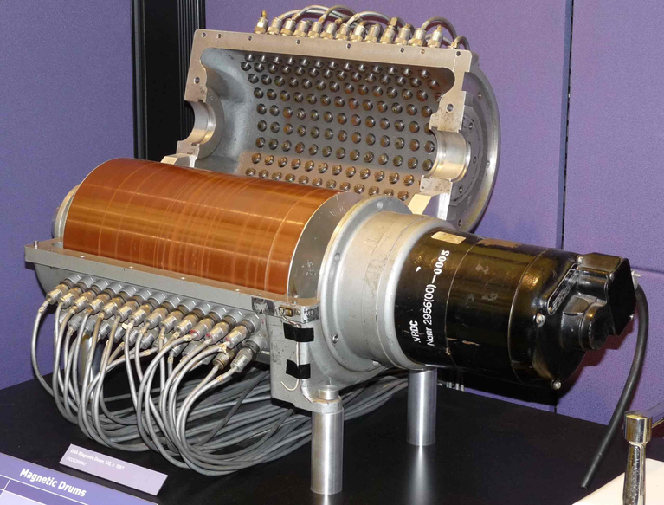
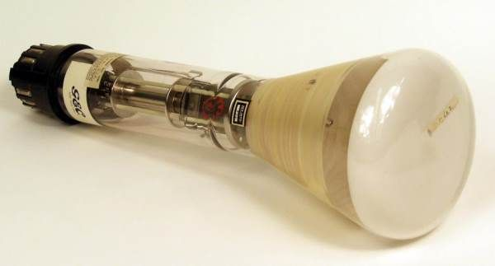
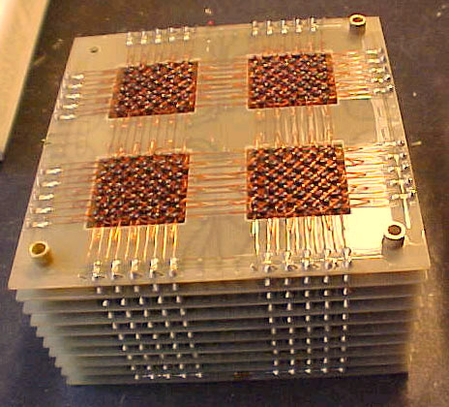
Initial Storage Technologies
Magnetic Drum Memory
Williams-Kilburn Tube
Magnetic Core Memory

Slide 57
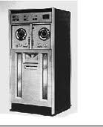
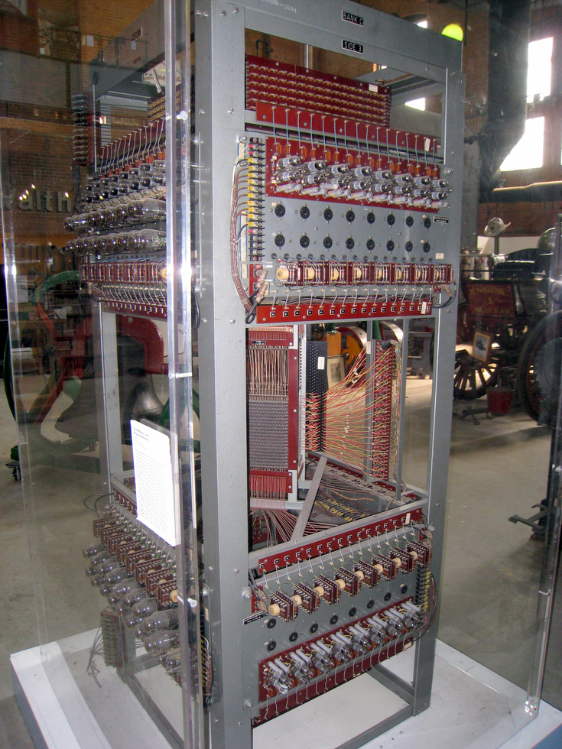
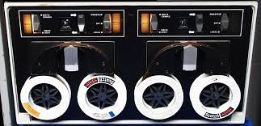
Magnetic Tape-Based Technologies
UNISERVO Tape Drive
Whirlwind Core Memory
DEC Tape

Slide 58
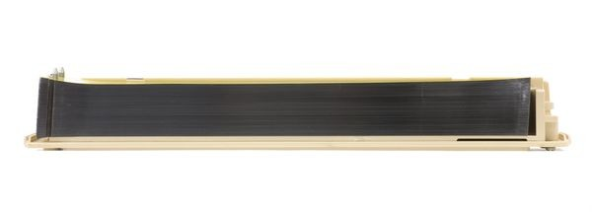
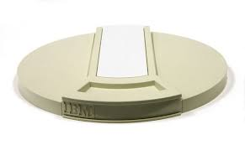

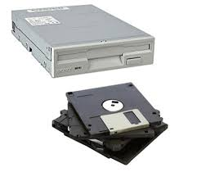
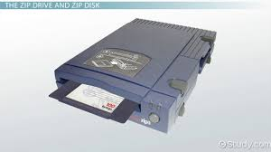
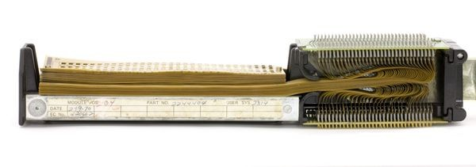
Magnetic Disk-Based Technologies
Card Random Access Memory
Disk Cartridge
Hard Disk Drive
Floppy Disk Drive
Zip Disk Drive
Transformer Read Only Storage

Slide 59
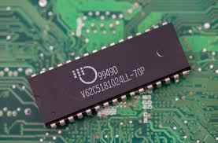
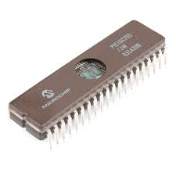
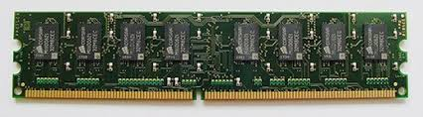
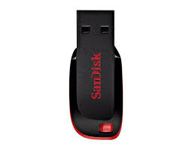
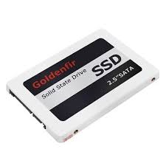
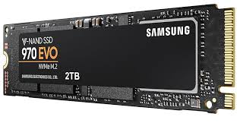
Semiconductor-Based Storage Technologies
Static Random Access Memory
Dynamic Random Access Memory
Electrically Erasable Programmable Read Only Memory
Flash Drive
Solid State Disk

Slide 60
Optical-Based Storage Technologies
CD ROM—Compact Disc Read Only Memory
DVD ROM—Digital Versatile Disc Read Only Memory
DVD RAM—Digital Versatile Disc Random Access Memory
HD DVD—High-Deinition Digital Versatile Disc
Blu Ray—High-Deinition and Large Capacity Optical Discs
CD-R/W—Compact Disc Re-Writable
DVD-R/W—Digital Versatile Disc Re-Writable.

Slide 61
advanced storage technologies
1
Direct Attached Storage (DAS)
2
Network Attached Storage (NAS)
3
Storage Area Network (SAN)

Slide 62
Direct Attached Storage (DAS)
The storage devices such as Hard Disk Drive (HDD), Solid State Drive (SSD), or optical storage devices connected directly with the computers internally or externally are referred to as directly attached storage systems.
Serial Advanced Technology Attachment (SATA)
Small Computer System Interface (SCSI)
Peripheral Component Internet Express (PCIe)
Serial Attached SCSI (SAS).

Slide 63
Network Attached Storage (NAS)
A centralized node of data storage with independent IP address connected in a network for providing the shared data storage for different computers on a network is known as network-attached storage coniguration (NAS)
Common Internet File System
(CIFS) Network File System (NFS)
Server Message Block (SMB).

Slide 64
Storage Area Network (SAN)
Storage-area-network, precisely known as SAN, is a network of data storage machines with extensive management, operations, and security features.
Fiber Channel Coniguration
Internet SCSI (iSCSI—Internet Small Computer System Interface)
Fiber Channel Over Ethernet (FCoE).

Slide 65
Futuristic Storage Technologies
Software-Defined Storage (SDS) is a comprehensive software layer that is used to separate the storage hardware equipment from the storage software that manages the data storage resources.

Slide 66
Futuristic Storage Technologies
Storage virtualization is a process to accumulate multiple data storage devices or underlying storage hardware to create a large pool of data and make it available for separate machines or servers as one single storage.

Slide 67
Software Development Generations
1
Conventional Era—(1960–1970)
2
Transition Era—(1980–1990)
3
Modern Era—(2000–Present)

Slide 68
Conventional Era—(1960–1970)
This era is mostly dominated by highly skilled and expert computer programmers; that is why, it is also referred to as craftsmanship era.

Slide 69
Transition Era—(1980–1990)
The second-generation of software development is marked as the software engineering era. This era is more sophisticated and advanced in terms of programming languages, tools, methodologies, and advancement in the ICT technologies.

Slide 70
Modern Era—(2000–Present)
Modern era, alternatively referred to as the third-generation software development, is also termed as software production era. The development of software has become systematic and planned—this is indeed a full-ledged production era for software applications, products, and platforms.

Slide 71

Types of ICT Services
Software Development
Process Automation and Monitoring
Computer Networking
Data Analytics
IT Infrastructure Management
Cloud Computing Service
Telecommunication
API Service
Data Storage Service
CyberSec Service
Digital Entertainment Service
Storage Transfer Service (STS)
Content Delivery Network (CDN)
Database Management

Slide 72
A Peep into Next Generation Technologies
Artiicial Intelligence (AI)
Machine Learning (ML)
Blockchain Technology
5th Generation Wireless
Internet of Things (IoT)
Distributed Cloud Computing
Quantum Computing
Tactile Virtual Reality (TVR)
3D Printing Digital
Twin Technology
Mind Uploading Technology
Autonomous Robotics
Artiicial Neuron Technology

Slide 73

THANK YOU FOR LISTENING!

